Slide 1
ECE 385 – Digital Systems Laboratory
Combined Lecture Slides
Zuofu Cheng
Fall 2022
Link to Course Website
Notes:
ECE Main Slide

Slide 2

VGA Monitor Operation
In lab 6, we used a simple color mapper combined with the VGA controller to draw simple shapes
Color mapper needs to have as inputs the horizontal and vertical position counters, and maps output color either to foreground color (e.g. red) or background color (e.g. white)
Columns
0 1 2 3 4 639
X →
Y
↓
Line 0
Line 1
Line 2
pixel (638, 2)
pixel (2, 476)
Line 475
Line 476
Line 477
Line 478
Line 479
pixel (639,479)

Slide 3
Limitations of Simple Approach
If we strictly draw based on H and V pixel positions, we can only draw boxes
What if we want to draw more sophisticated graphics (circles, fonts, spaceships, Mario?)
We do not want to instantiate logic which describes everything we would ever want to draw – want instead to make generalized hardware to draw whatever software can describe
In general, we want design to be data driven and not logic driven

Slide 4
Two Fundamental Approaches to Drawing
Fixed Function
Fixed function hardware has limited number of primitives which may be on-screen at once
Breaks down graphics into smaller sprites and tiles
Plus: doesn’t need memory to hold screen
Minus: limited by number of sprites, sprite size, hard to do effects such as transparency, scrolling, unless specialized hardware is designed
Frame Buffer
Stores entire contents of screen to be drawn into high speed memory (frame buffer)
One side of memory goes to video controller, other side goes to blitter (memory copy unit)
Plus: limited only by performance of memory and blitter, can do effects easily
Minus: needs enough memory to hold the screen (possibly twice over)

Slide 5
Experiment 7 Introduction
Week 1 – Create a monochrome graphics controller for the Nios II to be connected via Avalon bus
Support 80x30 text mode and 128 glypths (character bitmaps)
Support per character ‘inverse’ attribute, to draw the glyph with inverted colors
Support per screen colors – colors will be the same for the whole screen (will change for Week 2)
Demo:
1 point: Correct drawing of a single font character.
1 point: Correct drawing of the inverse color characters.
1 point: Correct drawing of the different background and foreground colors.
2 point: Correct drawing of the test program animation without glitches or incorrect pixels

Slide 6
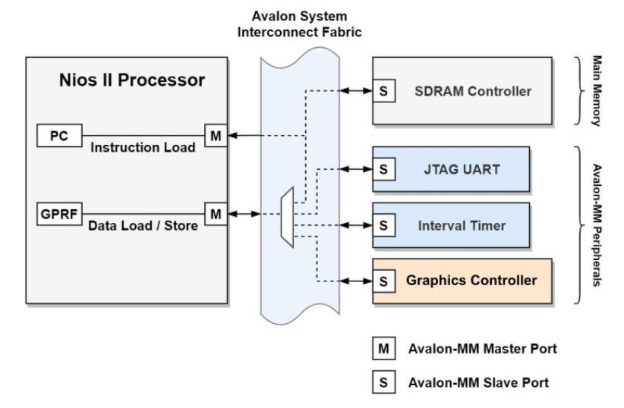

Nios II System Components in Lab 7
Create an Avalon MM interface
Decode 601 registers to use for HW/SW communication

Slide 7
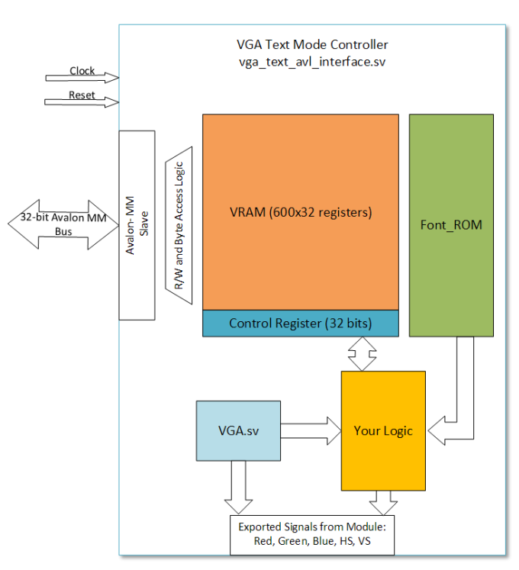

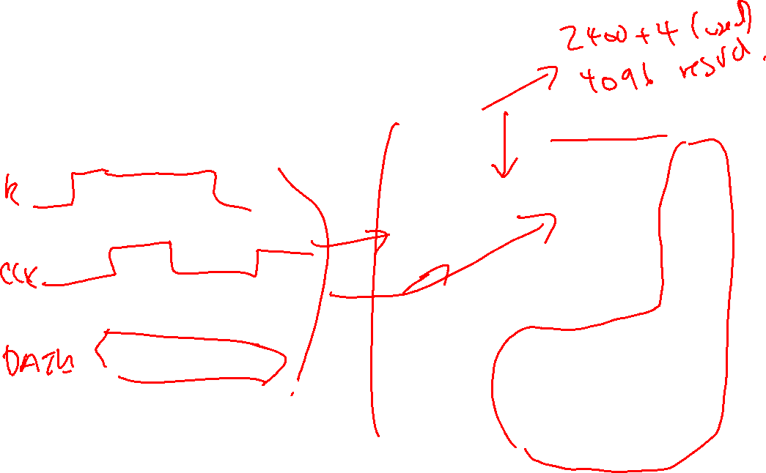
VGA Text Mode Controller
600 words of VRAM, 1 control register
How many bytes on Avalon bus?

Slide 8
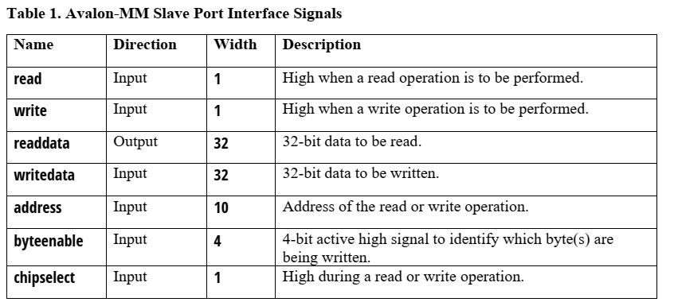
Avalon MM Interface Signals
You will create a module which will decode Avalon bus (following chart) and place data into 601 registers
Note address is only 10 bits, don’t need to decode full 32-bit address

Slide 9
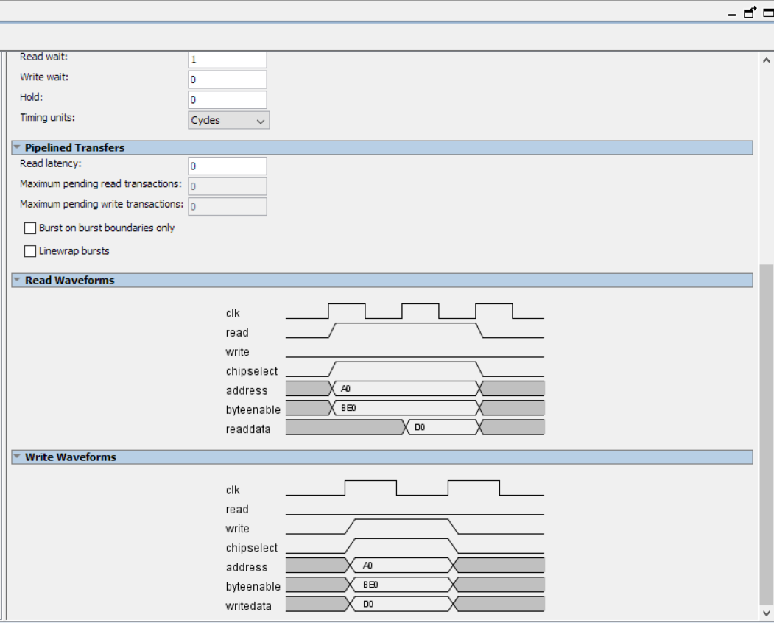
Read/Write Timing
We will use the Avalon-MM bus with fixed wait-states
Read wait = 1, write wait = 0
This can be done automatically using always_ff (if using registers for VRAM)
May need to be increased to use OCM for Week 2

Slide 10
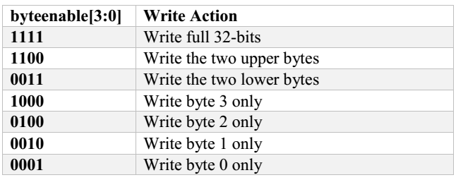
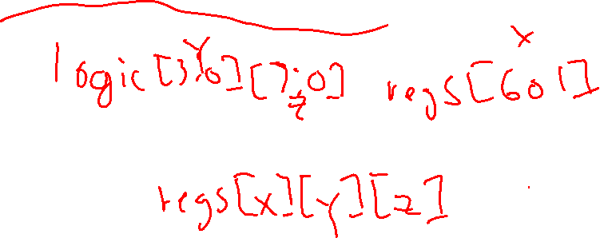

Byte Enable Support
Must support byte enable on Avalon writes (to FPGA registers)
Recommended design:
Remember that accessor ‘[]’ goes left to right, unpacked dimension first!
Notes:
if (AVL_CS & AVL_WRITE) begin
// Write each byte only if the corresponding byte enable is 1
LOCAL_REG_INPUT[AVL_ADDR][7:0] = AVL_BYTE_EN[0] ? AVL_WRITEDATA[7:0] : LOCAL_REG[AVL_ADDR][7:0];
LOCAL_REG_INPUT[AVL_ADDR][15:8] = AVL_BYTE_EN[1] ? AVL_WRITEDATA[15:8] : LOCAL_REG[AVL_ADDR][15:8];
LOCAL_REG_INPUT[AVL_ADDR][23:16] = AVL_BYTE_EN[2] ? AVL_WRITEDATA[23:16] : LOCAL_REG[AVL_ADDR][23:16];
LOCAL_REG_INPUT[AVL_ADDR][31:24] = AVL_BYTE_EN[3] ? AVL_WRITEDATA[31:24] : LOCAL_REG[AVL_ADDR][31:24];
end
else ;

Slide 11
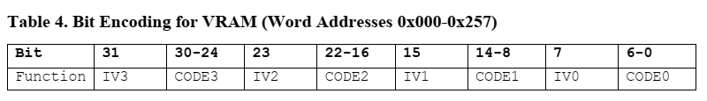
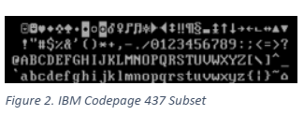
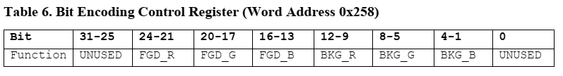
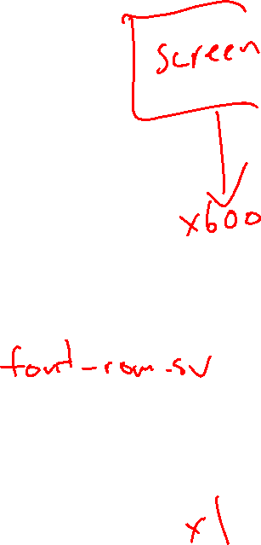
Character Encoding & Colors
Each character is encoded with 8-bits (1 byte)
Each 32-bit word of VRAM holds 4 characters
CODEn refers to index into codepage 437:
7-bit index to address one of 128 characters
Note this is a superset of ASCII, so you can use strcpy(), memcpy() functions directly into VRAM to draw text on the screen.
INVn is bit flag to indicate draw character with inverted colors:
Notes:
if (AVL_CS & AVL_WRITE) begin
// Write each byte only if the corresponding byte enable is 1
LOCAL_REG_INPUT[AVL_ADDR][7:0] = AVL_BYTE_EN[0] ? AVL_WRITEDATA[7:0] : LOCAL_REG[AVL_ADDR][7:0];
LOCAL_REG_INPUT[AVL_ADDR][15:8] = AVL_BYTE_EN[1] ? AVL_WRITEDATA[15:8] : LOCAL_REG[AVL_ADDR][15:8];
LOCAL_REG_INPUT[AVL_ADDR][23:16] = AVL_BYTE_EN[2] ? AVL_WRITEDATA[23:16] : LOCAL_REG[AVL_ADDR][23:16];
LOCAL_REG_INPUT[AVL_ADDR][31:24] = AVL_BYTE_EN[3] ? AVL_WRITEDATA[31:24] : LOCAL_REG[AVL_ADDR][31:24];
end
else ;

Slide 12
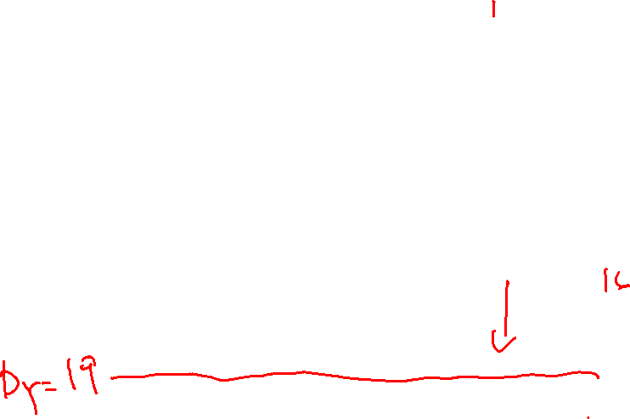
VRAM Layout
Your design should have 2400 bytes of VRAM (600 32-bit registers/RAM)
VRAM is directly accessible through Avalon bus
Example:
VRAM[0x15] = 0x0101038E
0x15 = 21(d)
21 * 4 = 84
84 / 80 (columns) = row 1
84 % 80 = column 4
8E = R1/C4 note: inverted
03 = R1/C5
01 = R1/C6
01 = R1/C7
Note that Nios II is little endian!
 | 0 | 1 | 2 | 3 | 4 | 5 | 6 | 7
0 | - | - | - | - | - | - | - | -
1 | - | - | - | -
2 | - | - | - | - | - | - | - | -
Notes:
if (AVL_CS & AVL_WRITE) begin
// Write each byte only if the corresponding byte enable is 1
LOCAL_REG_INPUT[AVL_ADDR][7:0] = AVL_BYTE_EN[0] ? AVL_WRITEDATA[7:0] : LOCAL_REG[AVL_ADDR][7:0];
LOCAL_REG_INPUT[AVL_ADDR][15:8] = AVL_BYTE_EN[1] ? AVL_WRITEDATA[15:8] : LOCAL_REG[AVL_ADDR][15:8];
LOCAL_REG_INPUT[AVL_ADDR][23:16] = AVL_BYTE_EN[2] ? AVL_WRITEDATA[23:16] : LOCAL_REG[AVL_ADDR][23:16];
LOCAL_REG_INPUT[AVL_ADDR][31:24] = AVL_BYTE_EN[3] ? AVL_WRITEDATA[31:24] : LOCAL_REG[AVL_ADDR][31:24];
end
else ;

Slide 13
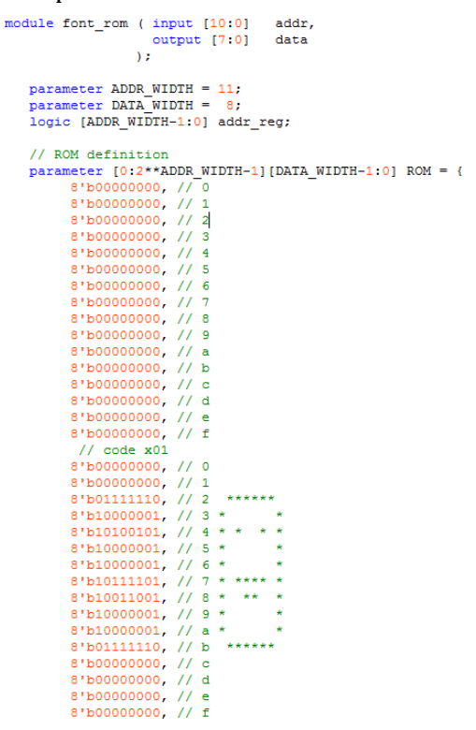

Font ROM
Each glyph is represented as 8x16 pixels, to give a total display of 640/8 = 80 columns and 480/16 = 30 rows
font_rom.sv is provided, which implements asynchronous ROM (not very efficient, but don’t need to worry about wait states)
Note that each address represents a row of pixel data, so you will want to address based on subset of drawY (and the glyph code)
The 8-bit output data gives the pixels of the row, so you will want to address using subset of drawX (note that you’ll want to address data from right to left, otherwise glyph will draw mirrored)
If character is not inverted, ‘1’ is drawn with foreground color, ‘0’ is drawn with background color
Notes:
if (AVL_CS & AVL_WRITE) begin
// Write each byte only if the corresponding byte enable is 1
LOCAL_REG_INPUT[AVL_ADDR][7:0] = AVL_BYTE_EN[0] ? AVL_WRITEDATA[7:0] : LOCAL_REG[AVL_ADDR][7:0];
LOCAL_REG_INPUT[AVL_ADDR][15:8] = AVL_BYTE_EN[1] ? AVL_WRITEDATA[15:8] : LOCAL_REG[AVL_ADDR][15:8];
LOCAL_REG_INPUT[AVL_ADDR][23:16] = AVL_BYTE_EN[2] ? AVL_WRITEDATA[23:16] : LOCAL_REG[AVL_ADDR][23:16];
LOCAL_REG_INPUT[AVL_ADDR][31:24] = AVL_BYTE_EN[3] ? AVL_WRITEDATA[31:24] : LOCAL_REG[AVL_ADDR][31:24];
end
else ;

Slide 14

Memory Technology Comparison
Technology | R/W | Size | Speed | Complexity | Initialization
On-Chip Memory (M9K) | R/W | 182 M9K blocks 9216 bits per block 1,638 kBit (~200 kByte) | Very Fast | Low | Directly in SV or Quartus GUI
On-Chip Flash | R (mostly) | 5888 kBit (~736 kByte) | Medium | Low | Quartus GUI or Platform Designer
SDRAM | R/W | 32M x 16 512 Mbit (~64MByte) | Fast | High | Control Panel

Slide 15
On-Chip Memory
Tightly coupled to FPGA logic (on the same die)
Synchronous SRAM technology, organized internally as 256x36
Can be rearranged (e.g. 256x36, 512x18, 1024x9, etc…)
Single port or dual port, single or dual clock
Can be used as addressed memory or FIFO
Maximum clock = 274 MHz (e.g. can run as fast as logic in almost all cases)

Slide 16
On-Chip Memory Continued
OCM must be synchronous
M9K blocks cannot be used for asynchronous memory
Latches and/or combinational logic will be used for asynchronous memories (typically considered bad design, latches are poor use of FPGA area)
Check “total memory bits” in Place & Route report to see if memory successfully inferred

Slide 17

On-Chip Memory Continued
Can simply instantiate using SystemVerilog
FPGA Synthesis will infer (automatically use) M9K blocks if it can understand HDL
Refer to Recommended HDL coding Styles to make sure inference works
Can also instantiate in Qsys for use in SoC (e.g. as program memory)
Alternatively, you can use the GUI tools (Megafunction) which gives you SystemVerilog module instantiation template
module ram_32x8(
output logic [7:0] q,
input [7:0] d,
input [4:0] write_address, read_address,
input we, clk
);
logic [7:0] mem [32];
Always_ff @ (posedge clk) begin
if (we)
mem[write_address] <= d;
q <= mem[read_address];
end
endmodule

Slide 18

On-Chip Memory Continued
If you want to initialize OCM, you should use the $readmem as specified in Recommended HDL Coding Styles
This will create a MIF (memory initialization file) which initializes the OCM at programming
Instead, use $readmem as specified in document, or initialize using GUI Megafunction
$readmemb, $readmemh, etc… are special commands recognized by the synthesis tool for binary, hex data
Place in initial procedure block
Even though initial is typically unsynthesizable, it doesn’t synthesize the $readmem command, the synthesis tool simply reads the file at compile time and extracts the contents
...
logic [7:0] ram[16];
initial
begin
$readmemh("ram.txt", ram);
end...
ram.txt:
24
34
2e
2e
2e
2e

Slide 19
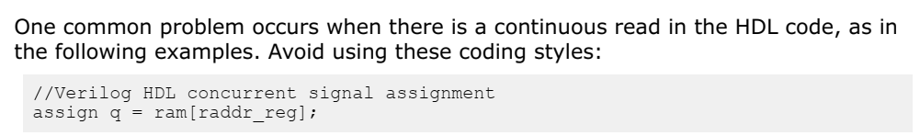
On-Chip Memory Continued
Note that unsupported behavior in HDL code will cause registers to be used instead of on-chip memory. This example is from Intel documentation (Recommended HDL Coding Styles):
What’s wrong here?
Use Megafunction GUI to ensure that on-chip memory is used.

Slide 20
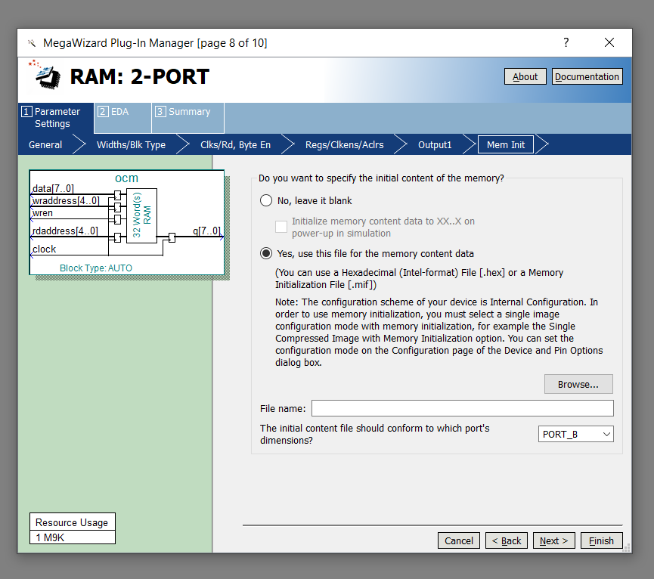
On-Chip Memory Continued
Alternatively, use the Quartus GUI to initialize OCM, though you will need to generate an Intel hex file (.hex) or memory initialization file (.mif)
Can instantiate/initialize on-chip flash memory using this method as well

Slide 21
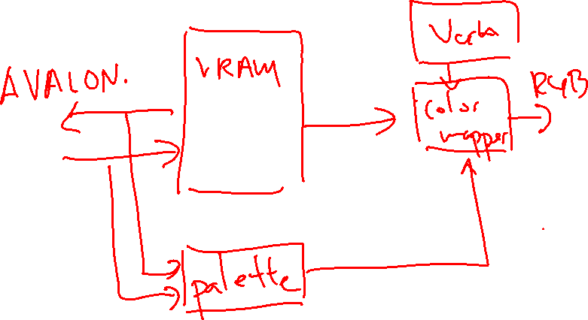
Ideas for Lab 7.2 VRAM side design

Slide 22
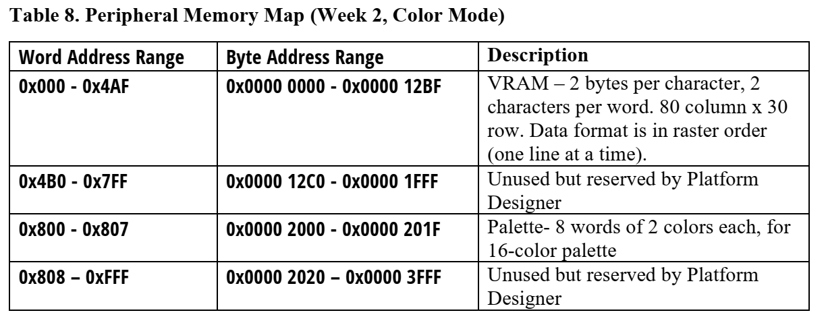

Memory Map for Lab 7.2
12-bit memory space for Lab 7.2
Note gap between end of VRAM and beginning of palette, allows the use of a single address bit to choose between VRAM and palette (ADDR[11])
Must account for this in your software

Slide 23
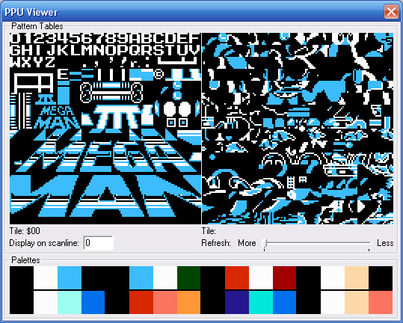
Palettized Colors
Lab 7.2 will use palette to draw colors
Palette is just look-up-table for each color
Normally each pixel requires 12-bits (4 red, 4 green, 4 blue)
Palette maps smaller index (e.g. 4-bit number) to 12-bit color
Many tools available online to generate palette (finds closest colors, quantizes colors, generates a table)
Can use for animation as well (palette cycling)
0 | 1 | 1 | 0
1 | 2 | 2 | 1
1 | 2 | 2 | 1
0 | 1 | 1 | 0

Slide 24
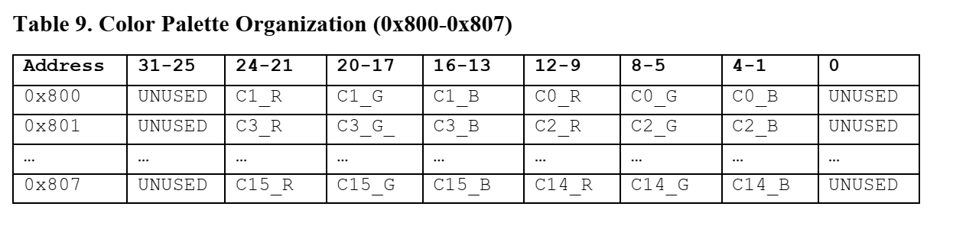

Palettized Layout in RAM
Colors are packed into palette 2 colors per word.
16 colors total, so 8 32-bit words of palette registers
Note the bit field locations for red/green/blue, same as control register from Week 1

Slide 25

Palette Loading Code
You need to write some code to fill in the palette registers:
May have to modify the struct associated with the module:
void setColorPalette (alt_u8 color, alt_u8 red, alt_u8 green, alt_u8 blue)
{
struct TEXT_VGA_STRUCT {
alt_u8 VRAM [ROWS*COLUMNS*2]; //Week 2 - extended VRAM

Slide 26
Final Project Proposal
During week after Experiment 7.2 turn in final project proposal
Turn in via Compass just as with lab report
See template document on webpage under Final Project
TAs will grade your proposal (10 points) and give you feedback
Estimate difficulty points for assignment
Suggest additions or subtractions to features for demo
Required lab sessions during final project are mid-checkpoint and final demo (other lab sessions are optional; TA will be present)

Slide 27
Final Project Proposal
Final project proposal point breakdown as follows:
Final project proposal should be about 1-2 pages long
As long as you spend time researching and thinking about final project, proposal should get full credit
In previous semesters, some students would not think about project early and write one-sentence proposals that were not thought out – leading to failed final projects!
Having the proposal worth significant points forces you to get started on thinking about your project early!
Item | Points
Idea and Overview | 2.0
Block Diagram | 2.0
List of Features | 2.0
Expected Difficulty and Justification | 2.0
Proposed Timeline | 2.0
Total | 10.0

Slide 28
Final Project Proposal – Overview
Your overview should be in abstract form and consist of one or two paragraphs summarizing your project
Describe what the final design should do and how it should go about doing it
Should show some hours of technical research
It should describe key components/features the game should have and what the general design approach is
If you use a SoC, you should summarize which functions are software or hardware
If you plan on using existing code, you should cite where you are getting the code from and make sure you can get it
Describe how you are going to demo the design, especially if it is not obvious (e.g. if you are designing a CPU, how are you going to show that it works?)

Slide 29

Final Project Proposal – Overview Example
We propose to design and implement an Apple IIe computer on the FPGA as a System-on-chip. Our SoC will be based around a SystemVerilog 6502 CPU core which is found here (link). Additionally, we will implement using SystemVerilog essential components such as the System Bus, RAM, Video Display, Keyboard, and Emulated Disk Drives. Our design will also include a NIOS II CPU for the purposes of interfacing with the USB keyboard as in lab 8 to emulate the Apple keyboard. Our goal is to demonstrate our IIe SoC using the USB keyboard and VGA monitor, running a copy of The Oregon Trail.

Slide 30
Final Project Proposal – Block Diagram
Your proposal should include a block diagram listing all the hardware modules you expect to need
Individual signals do not need to be shown, but you should show the dataflow
Dataflow diagram: which modules need to communicate with which other modules, and using what data?
If you have graphics, where are the graphic data (sprites) stored?
What module takes the sprite data, how does it take in commands?
What are the various busses that your CPU design will need?
How does the hardware communicate with the software?

Slide 31
Final Project Proposal – List of Features
List of features, split into two categories:
Baseline set of features for the project to be considered working
Additional features that may be implemented for extra difficulty
Elaborate on any features which are not self-explanatory – be as specific as possible
Also elaborate on how you will demo a feature if it is not obvious
For example, if you claim that you will have accurate ghost AI in Pac-Man, how will you demonstrate this to someone unfamiliar with the game?
This is primarily how we will evaluate the functionality of your final demo

Slide 32
Final Project Proposal – Expected Difficulty
Give an expected range of difficulty for your project (from 0 to 10)
Give justification for this range
This will use the same “scale” as the difficulty points awarded by your TA (also out of 10 points)
Some rough examples:
Basic snake (0 – very easy)
Basic breakout – static blocks, no power-ups, no animation (0 – very easy)
Full featured breakout – different levels, animation, power-ups (3 – medium easy)
Missile command – accurate gameplay, USB trackball/mouse (5 – medium)
Tetris – accurate gameplay, score keeping, etc (5 – medium)
Rhythm game – sound (PCM or MIDI), controller support, (7 – medium difficult)
Apple IIe computer running graphical games (10 – very difficult)
Classic Macintosh computer running OS (10 – very difficult)
Full Arkanoid (Breakout) arcade hardware emulation (10 – very difficult)
Use this opportunity to highlight those aspects of your project which may increase the difficulty that may not be initially obvious

Slide 33
Final Project Proposal – Timeline
Include an approximate timeline, should be at least week granularity
Project Week 1: 4/11
Submit a detailed project proposal on Monday, April 11th. Note that this is the Monday after the Lab 7.2 demo. This is worth 10 points.
Work on your final project, lab is optional this week.
Project Week 2: 4/18 - Note: this is also the due date of Lab Report 7.
Required (4/22): Mid-checkpoint with your TA. You should show tangible progress to your TA, as described in your proposal.
Not showing up will result in a 0 for the mid-checkpoint score.
You will receive no points if you show no final project progress even if you show up.
Project Week 3: 4/25
Work on your final project, lab is optional this week.
Project Week 4: 5/2
Work on your final project, lab is optional this week.
Demo project on Friday, May 6th.
Note that this is the first day of Final Exams - if you have a conflict, you should email your TA and set up a demo over the weekend.
Be specific about what you plan to demo on the mid-project checkpoint

Slide 34
Hints for Final Project
Propose a final project which can scale up and down
Be wary of projects which require critical hardware to work
Always have a backup plan, what can you demo if things don’t go as planned
Games are a popular choice because features may be scaled up and down (e.g. can still get some demo points for Pac-Man even if there are no working ghosts)
Design pessimistically (assume things will be hard to get working), always unit test
Use SoC to your advantage
Good hardware/software partitioning is essential to impressive project
Use software for low performance portions (e.g. game state, AI) and hardware for high performance portions (graphics, sound)

Slide 35
My (ECE 395) Final Project
My 395 final project (using Xilinx XC2S50 – 1,728 LEs) – but full semester
Keep in mind, DE10-Lite (Mx10M50 – 50k+ LEs)
Your final project should be 30+ times better!/s

Slide 36
Final Project Recommendations
Design pessimistically – always assume a module that you just wrote won’t work right away
Test each module, even if it seems trivial – even a simple flat testbench will suffice in most cases
Always have something that works before adding a new module, always make sure you have some source control (e.g. Git/Dropbox), so that you can revert to a working copy
Better to work together on same modules (pair/peer program) than split up tasks between partners
Do not split up tasks such that project will completely fail if one partner fails to deliver

Slide 37

Final Project Recommendations
Do not split up tasks such that project will completely fail if one partner fails to deliver (courtesy of the Facebook meme group)

Slide 38
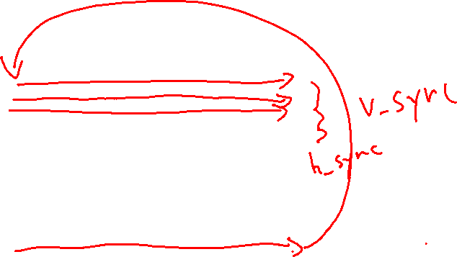
VGA Monitor Operation
VGA (Video Graphics Array) Standard
The screen is organized as a matrix of pixels
640 horizontal pixels x 480 vertical lines
An Electron Beam “paints” each pixel from left to right in each row, and each row from top to bottom
Columns
0 1 2 3 4 639
X →
Y
↓
Line 0
Line 1
Line 2
pixel (638, 2)
pixel (2, 476)
Line 475
Line 476
Line 477
Line 478
Line 479
pixel (639,479)

Slide 39
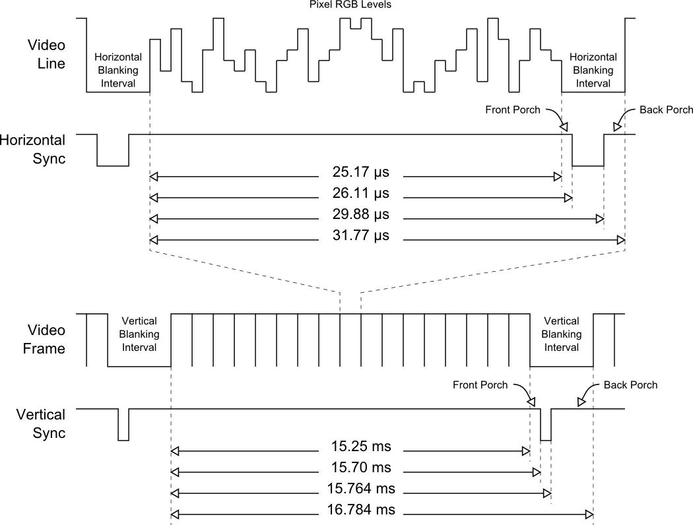
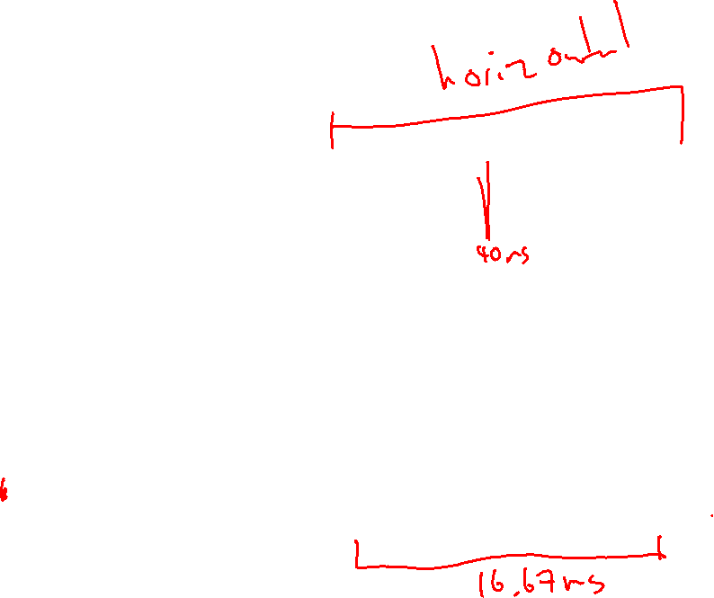
VGA Timing (continued)
Screen refresh rate = 60 Hz
Note: this doesn’t mean your game must run at 60 Hz
But you must generate VGA signal 60 times a second!
One frame = 16.67 ms
Overall pixel frequency = 25.175 MHz
Can approximate by using 25.000 MHz (50 MHz / 2 using flip flop)
Makes frame time longer, now 16.784 ms
Note: VGA communicates via analog voltages (DE2-10 has DAC to generate these)
Generate by PLL (why is this better?)

Slide 40

VGA Horizontal Timing
To generate a Horizontal Sync Pulse, use a 10-bit pixel counter modulo-800
Counter increments with a 25MHz clock (pixel clock)
Pixel Counts <0 thru 639>: Display On
Pixel Counts <640 thru 799>: Display Off
Pixel Count <656 thru 751>: HS Pulse Active for 96 pixels
Pixel Count 799: Reset pixel counter
HS Pulse is Active Low for most monitors
Note: many monitors require you draw black (0,0,0) during the blanking interval, or colors will look “washed out”.
HS
HS
back
porch
Display On for
640 pixels
front
porch
back
porch
656-751 0 639 656-751 799/0

Slide 41
VGA Vertical Timing
To generate Vertical Sync Pulse (VS), start a 10-bit Line Counter modulo-525
Counter increments every 800 pixels
Line Counts <0 thru 479> : Display On
Line Counts <480 thru 524>: Display Off
Line Counts 490 and 491: VS Pulse Active
Line Count 524: Reset Line Counter
VS Pulse is Active Low for most monitors
Games typically use VS pulse to signal a new frame and clock game logic (update player, enemies, physics, collisions, etc).
VS
VS
back
porch
Display On for
480 Lines
front
porch
back
porch
490 491 0 479 490 491 524/0
Line Counter
Reset
Line
Counter to 0

Slide 42
VGA Monitor Operation
In lab 6.2, we used a simple color mapper combined with the VGA controller to draw simple shapes
Color mapper needs to have as inputs the horizontal and vertical position counters, and maps output color either to foreground color (e.g. red) or background color (e.g. white)
Columns
0 1 2 3 4 639
X →
Y
↓
Line 0
Line 1
Line 2
pixel (638, 2)
pixel (2, 476)
Line 475
Line 476
Line 477
Line 478
Line 479
pixel (639,479)

Slide 43
Drawing Shapes (Simplest Approach)
A shape can be defined by specifying a boundary around a center. In the previous example, the center is (2, 476) and the box is defined Center ± Size. For Size=1 all pixels in the box satisfy:
(X≥2-1) AND (X≤2+1) AND
(Y≥476-1) AND (Y≤476+1)
Color mapper detects the condition and maps output color (combinationally) to foreground color if condition is satisfied, background color if condition is not satisified

Slide 44
Limitations of Simple Approach
If we strictly draw based on H and V pixel positions, we can only draw boxes
What if we want to draw more sophisticated graphics (circles, fonts, spaceships, Mario?)
We do not want to instantiate logic which describes everything we would ever want to draw – want instead to make generalized hardware to draw whatever software can describe
In general, we want design to be data driven and not logic driven

Slide 45
Two Fundamental Approaches to Drawing
Fixed Function
Fixed function hardware has limited number of primitives which may be on-screen at once
Breaks down graphics into smaller sprites and tiles
Plus: doesn’t need memory to hold screen
Minus: limited by number of sprites, sprite size, hard to do effects such as transparency, scrolling, unless specialized hardware is designed
Frame Buffer
Stores entire contents of screen to be drawn into high speed memory (frame buffer)
One side of memory goes to video controller, other side goes to blitter (memory copy unit)
Plus: limited only by performance of memory and blitter, can do effects easily
Minus: needs enough memory to hold the screen (possibly twice over)

Slide 46
Case Study: Ricoh RP2C02
Ricoh RP2C02 (NES PPU)
Break up background and foreground graphics into 8x8 or 8x16 tiles
Example tiles are shown on right
To further save memory, tiles saved in a paletted format
A palette is a look up table which maps an index (e.g. 5 bit for 32 colors) to a full range color (e.g. 24 bit for true color)
Can do graphical effects by swapping palettes (fade screen, animated water or fire)
PPU keeps track of horizontal and vertical position and draws background tiles according to a nametable, which maps tile position to tile index
Background tiles are drawn strictly on boundaries
Reduces memory required to keep track of background tiles
0 | 1 | 1 | 0
1 | 2 | 2 | 1
1 | 2 | 2 | 1
0 | 1 | 1 | 0

Slide 47
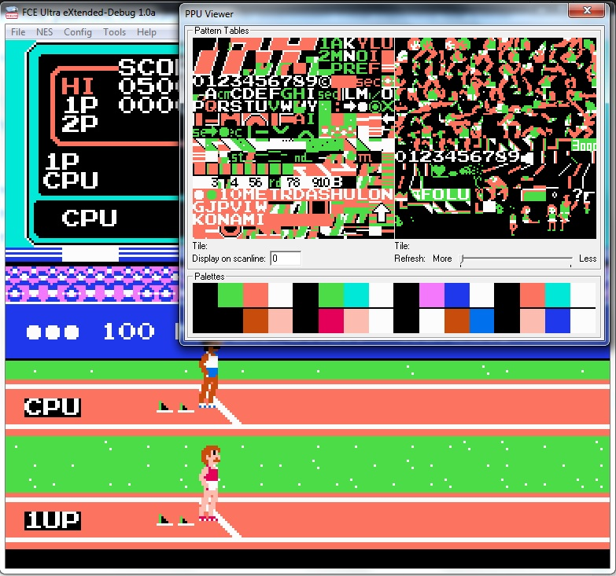
Case Study: Ricoh RP2C02 (continued)
Foreground drawn using limited number of hardware sprites (hardware graphic)
PPU supports 64 total sprites (8 per line max)
Each sprite is drawn from object attribute memory
Each OAM is a set of registers which keeps track of each hardware sprite
Data includes:
Index of tile to draw
Which palette to use
Position of sprite (sprites are not quantized to tile boundaries)
Optional bits to flip sprite vertically or horizontally
Priority (whether sprite is in front/behind background)
Each hardware sprite has dedicated hardware to detect whether it should draw, MUX selects between different sprites according to priority and sprite #

Slide 48

PPU Raster Process
Each hardware sprite keeps track of position range of itself based on position in OAM and system wide X and Y counter
Background unit also keeps track of which tile it should be drawing based on X and Y counter
When a hardware sprite has detected that it should currently be drawing it asserts an select pin to a wide MUX which gives it control over the color mapper
Color mapper then draws according to sprite tile and palette until X and Y counter have moved out of draw range for given hardware sprite
If no sprites assert select, select defaults to background unit to draw background tiles
All tile data may be stored in ROM, total RAM requirement is low (background tables, OAM, palettes, etc…)

Slide 49

Frame Buffer Approach
Find enough RAM which can hold all pixels in frame - for 640*480*12 bit, how much RAM is required?
RAM must be at least twice as fast as pixel clock to be able to do full frame animation – why?
One side of RAM -> Video DAC
Other side of RAM -> Drawing engine
Any suitable RAM spaces on the DE10?
VGA Controller
Addr = X + Y*Width
VGA DAC & Port
CPU or GPU
Frame Buffer RAM
HS
VS
Addr
Addr
VGA CLK (25 MHz)
Data
Data R/G/B color triples

Slide 50
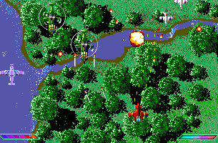
Frame Buffer
Frame Buffer
Last time we talked about fixed function drawing, what about frame buffer?
Frame buffer: a RAM which holds the contents of the screen to be drawn (every frame)
Need memory large enough to hold the entire screen
Every frame, VGA controller reads out contents of frame buffer and displays
Important concept: frame buffer is erased and regenerated every frame!
VGA Controller
DAC
VGA Monitor
Notes:
921600 bytes per frame for 24-bit color
307200 bytes for 8-bit color
614400 bytes for 16-bit color

Slide 51
Frame Buffer (continued)
Frame Buffer
VGA controller generates H and V sync signals (already provided in Lab 6/7 material)
Output (data) of frame buffer memory goes to VGA_R/VGA_G/VGA_B signals (how you store in memory is up to you)
Data should be read out in raster order (horizontal, and then down)
Note that no data has to be read out during blanking intervals
How fast do we need to read out of frame buffer RAM?
VGA Controller
DAC
VGA Monitor
Notes:
921600 bytes per frame for 24-bit color
307200 bytes for 8-bit color
614400 bytes for 16-bit color

Slide 52
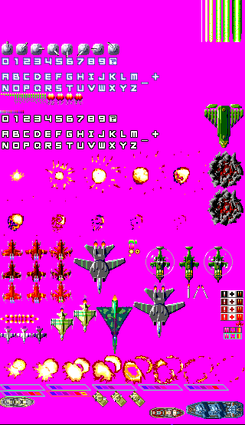
Frame Buffer Drawing
Sprite ROM
Remember that frame buffer has to be regenerated every frame (60 times a second)
Drawing engine is 2-D memory copy unit
Copies 2-D region of memory from ROM into video RAM based on commands from CPU
Example command: copy 64x64 region starting from address 0x100005020 to location 230x110
Drawing engine (blitter) must be aware of screen and ROM layout to correctly handle clipping
Sprites may be arbitrary sizes and not constrained in number
Performance is measured in megapixels/s drawn
Can draw over the same region multiple times (why would we want to do this?)
Draw Engine
Frame Buffer

Slide 53

Frame Buffer Approach (continued)
Sprite ROM
Typically draw background once (e.g. draw 640x480 region from current background ROM address to screen position 0,0)
Then draw sprites using same engine
Sprites need to have some sort of “transparent color” which tells draw engine to ignore specific pixel (otherwise sprites will be drawn with bounding boxes)
Must do drawing before VGA controller access pixel (otherwise will have flickering artifacts)
Can either do all drawing in vertical / horizontal blank interval or use double buffering
Using blank intervals limits performance (can only write when VGA controller is idle)
Using double buffering limits memory, need to hold two screens
Draw Engine
Frame Buffer

Slide 54
Memory Technology Comparison
Technology | R/W | Size | Speed | Complexity | Initialization
On-Chip Memory (M9K) | R/W | 182 M9K blocks 9216 bits per block 1,638 kBit (~200 kByte) | Very Fast | Low | Directly in SV or Quartus GUI
On-Chip Flash (UFM) | R (mostly) | 5888 kBit (~736 kByte) | Medium | Low | Quartus GUI or Platform Designer
SDRAM | R/W | 32M x 16 512 Mbit (~64MByte) | Fast | High | Control Panel

Slide 55
On-Chip Memory
Tightly coupled to FPGA logic (on the same die)
Synchronous SRAM technology, organized internally as 256x36
Can be rearranged (e.g. 256x36, 512x18, 1024x9, etc…)
Single port or dual port, single or dual clock
Can be used as addressed memory or FIFO
Maximum clock = 274 MHz (e.g. can run as fast as logic in almost all cases)

Slide 56
On-Chip Memory Continued
OCM must be synchronous
M9K blocks cannot be used for asynchronous memory
Latches and/or combinational logic will be used for asynchronous memories (typically considered bad design, latches are poor use of FPGA area)
Check “total memory bits” in Place & Route report to see if memory successfully inferred

Slide 57
On-Chip Memory Continued
Can simply instantiate using SystemVerilog
FPGA Synthesis will infer (automatically use) M9K blocks if it can understand HDL
Refer to Recommended HDL coding Styles to make sure inference works
Can also instantiate in Qsys for use in SoC (e.g. as program memory)
Alternatively, you can use the GUI tools (Megafunction) which gives you SystemVerilog module instantiation template
module ram_32x8(
output logic [7:0] q,
input [7:0] d,
input [4:0] write_address, read_address,
input we, clk
);
logic [7:0] mem [32];
Always_ff @ (posedge clk) begin
if (we)
mem[write_address] <= d;
q <= mem[read_address];
end
endmodule

Slide 58

On-Chip Memory Continued
If you want to initialize OCM, you should use the $readmem as specified in Recommended HDL Coding Styles
This will create a MIF (memory initialization file) which initializes the OCM at programming
Instead, use $readmem as specified in document, or initialize using GUI Megafunction
$readmemb, $readmemh, etc… are special commands recognized by the synthesis tool for binary, hex data
Place in initial procedure block
Even though initial is typically unsynthesizable, it doesn’t synthesize the $readmem command, the synthesis tool simply reads the file at compile time and extracts the contents
...
logic [7:0] ram[16];
initial
begin
$readmemh("ram.txt", ram);
end...
ram.txt:
24
34
2e
2e
2e
2e

Slide 59
On-Chip Memory Continued
Alternatively, use the Quartus GUI to initialize OCM, though you will need to generate an Intel hex file (.hex) or memory initialization file (.mif)
Can instantiate/initialize on-chip flash memory using this method as well

Slide 60
Saving Memory
Can use palette to save memory
Palette is just look-up-table for each color
Normally each pixel requires 24-bits (8 red, 8 green, 8 blue)
Palette maps smaller index (e.g. 8-bit number) to 24 bit color
Many tools available online to generate palette (finds closest colors, quantizes colors, generates a table)
Can use for animation as well (palette cycling)
0 | 1 | 1 | 0
1 | 2 | 2 | 1
1 | 2 | 2 | 1
0 | 1 | 1 | 0

Slide 61
Introduction to SDRAM
SDRAM stands for synchronous dynamic random access memory
Dynamic memory = made from small capacitors instead of logic gates
Dynamic memory has much higher density than static memory
Must be refreshed periodically to hold value (typically once every couple of milliseconds)
Traditionally addressed with multiplexed address lines (in a row/column fashion due to high density)
Synchronous = clocked
Responds to commands as signaled by CLE/CAS/RAS/WE
Typically driven by a state machine which is called the SDRAM controller
This abstracts the commands so that SDRAM looks like standard memory

Slide 62
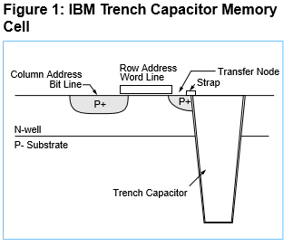
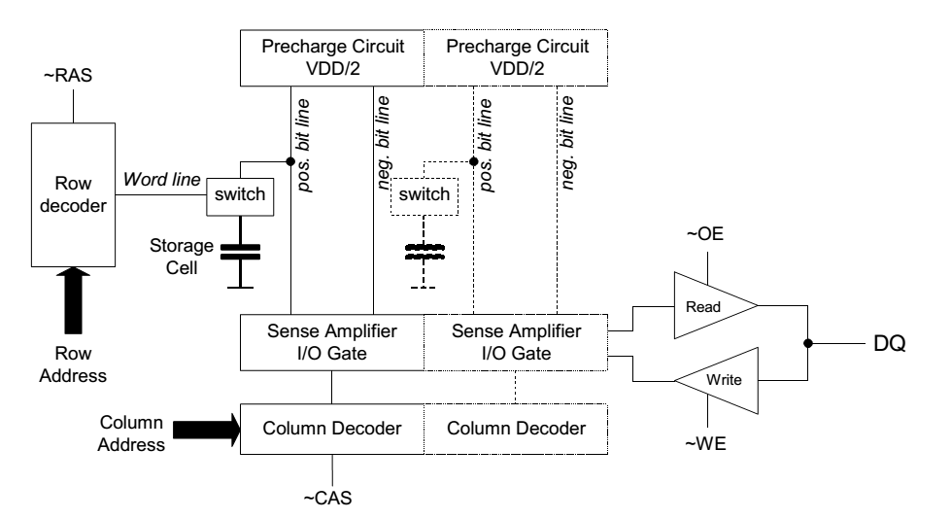
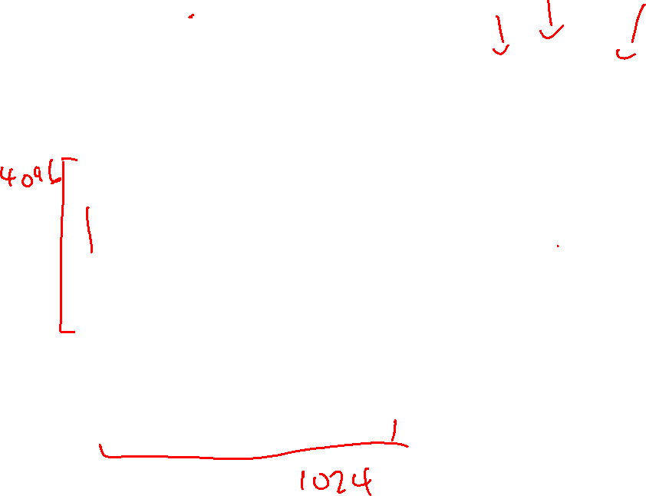
DRAM Basic Cell

Slide 63
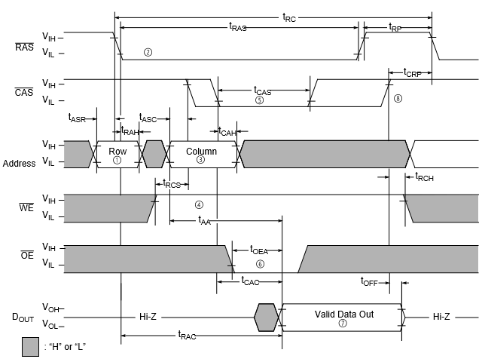
DRAM Read Cycle

Slide 64
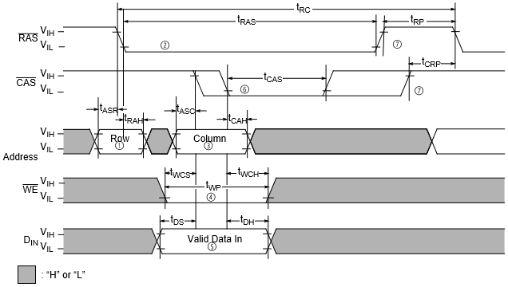
DRAM Write Cycle

Slide 65
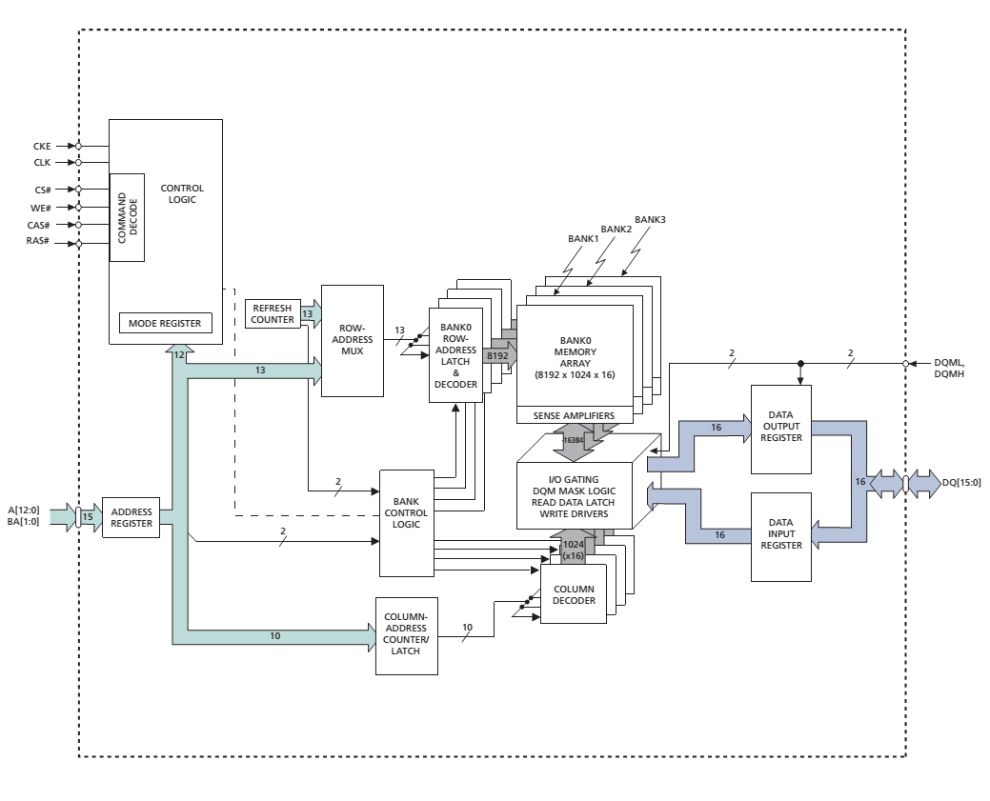

SDRAM Structure

Slide 66
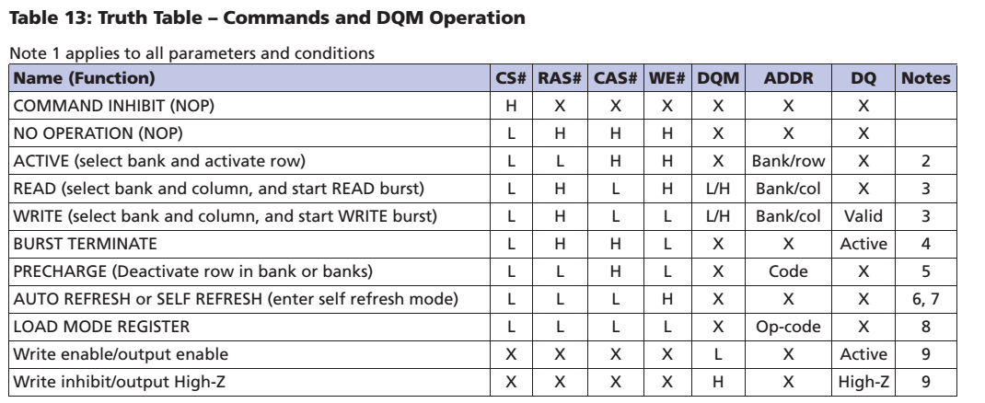
SDRAM Commands
Commands are combinations of CLE/CAS/RAS/WE
Note that SDRAM addresses are multiplex, typically rows are selected before columns using the same address pins

Slide 67
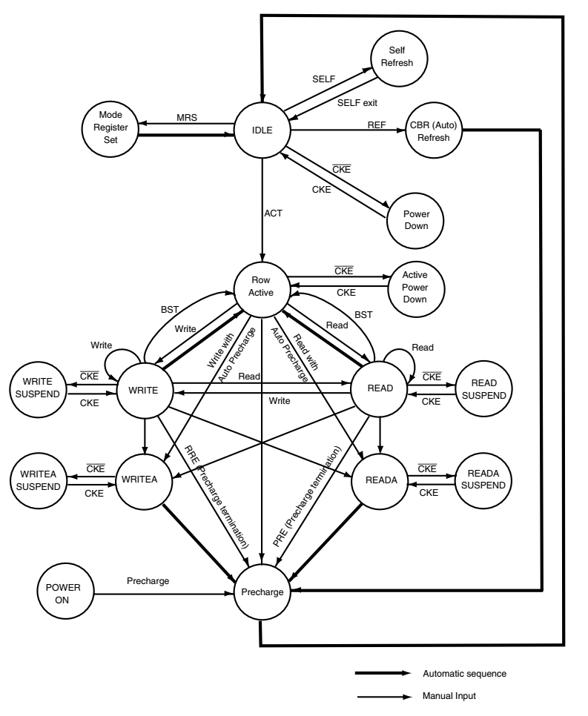

SDRAM Controller State Machine
SDRAM operates using commands
Controller needs internal timer to know when to send refresh operation
SDRAM chip needs to be initialized to get into the IDLE state
All SDRAM operations happen into a single row
ACTIVE command initializes row for R/W

Slide 68
SDRAM Controller State Machine
SDRAM can read/write words (columns) into a open row quickly
SDRAM can also automatically read/write successive words without the need for a column address (burst operation)
In order to read into another closed row, currently open row must be pre-charged to close

Slide 69
SDRAM Controller State Machine
Controller must also manage refresh, which is handled per row
Typically, each row needs to be refreshed every couple of milliseconds <100ms
This means controller must keep track of when row was last refreshed and which row to refresh next

Slide 70
SDRAM Timing
Because the SDRAM is synchronous, it requires a certain relationship between block and data to not violate setup and hold times
That relationship is difficult to maintain when the SDRAM chip is physically off chip from FPGA (differences in PCB routing, FPGA I/O buffer delays, etc.)
Use PLL (phase locked loop) to shift phase of the SDRAM’s clock relative to data (settings from Experiment 6 tutorial were provided by the manufacturer)
Additionally, SDRAM timings are typically given as CL, T_RCD, T_RP, T_RAS (e.g. 3-2-2-2)
Examples of various SDRAM operations found on next slides

Slide 71
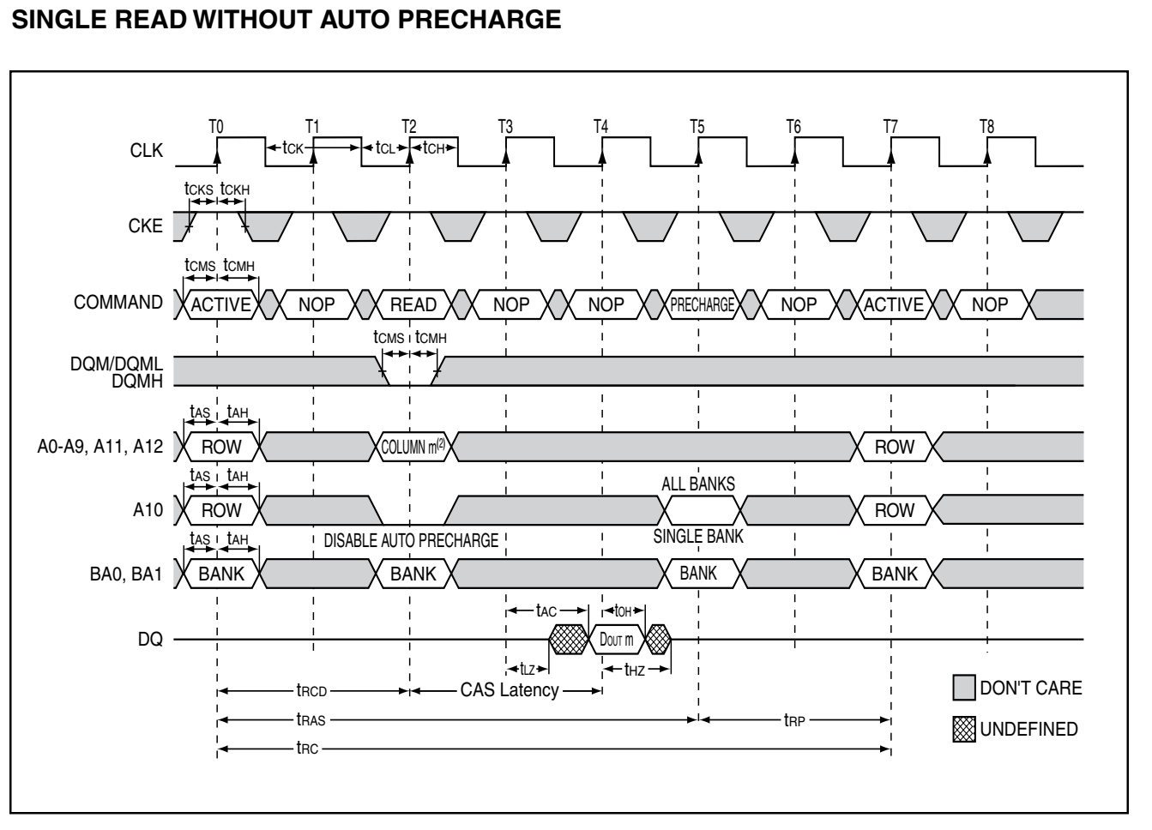
SDRAM Timing

Slide 72
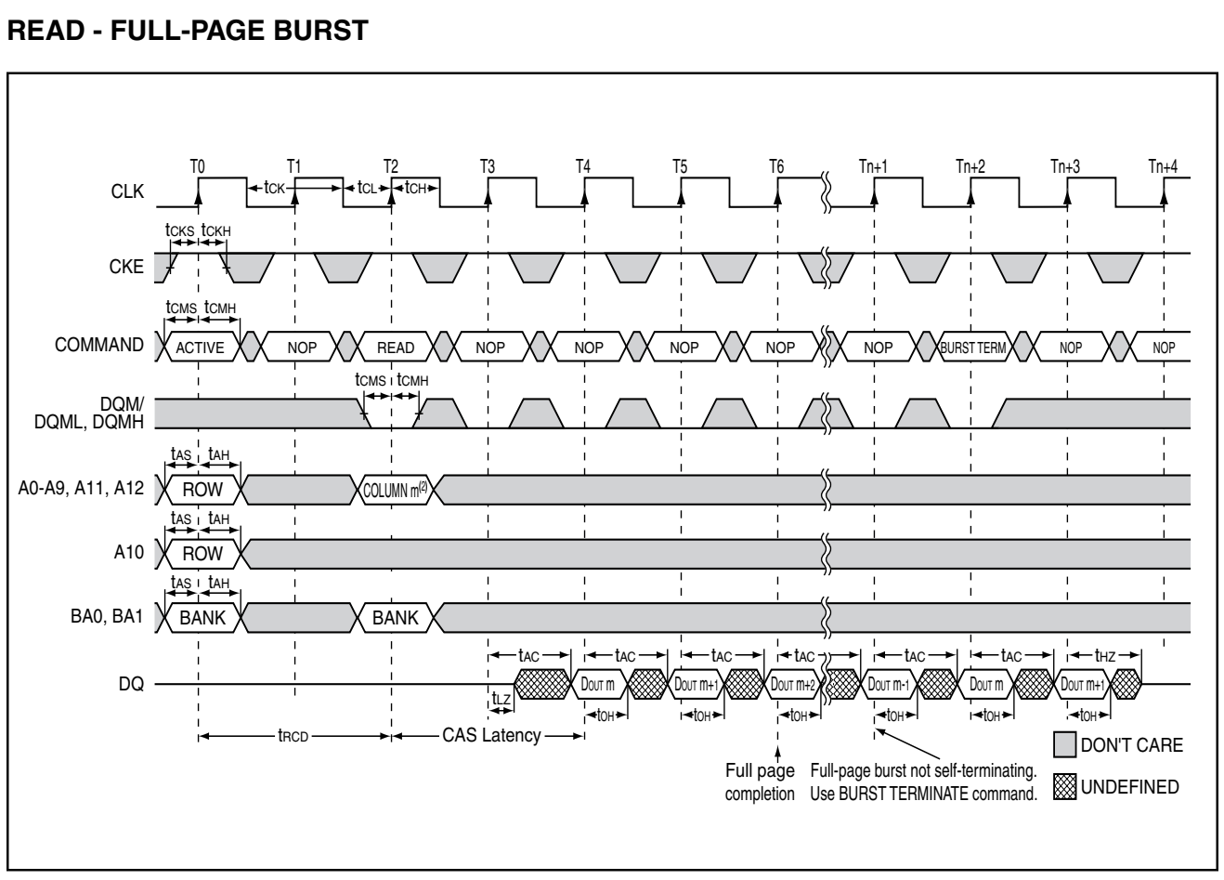
SDRAM Timing

Slide 73

Using SDRAM in FPGA Designs
DE10-Lite has 32Mx16 SDRAM chip (64 MBytes)
If using SDRAM in SystemVerilog, recommend starting from provided SDRAM controller (see DE10-Lite examples, SDRAM_RTL_TEST)
SDRAM contents can be pre-loaded using DE10-Lite Control Panel (using a .RAM file)
Will need to place NIOS II memory somewhere else if this is the case, simple to use on-chip memory
Remember to make OCM sufficient size for your ELF file (~64KB should be enough)
Modify BSP to locate segments (e.g. .text,) to OCM
Relocate the reset vector so your code executes out of OCM
Performance should be higher as well than execution from SDRAM
Modify BSP to “Use Small C” library
Check out Avalon Interface Specifications to do this, you will need to create a Avalon MM master for your FPGA logic to use SDRAM

Slide 74
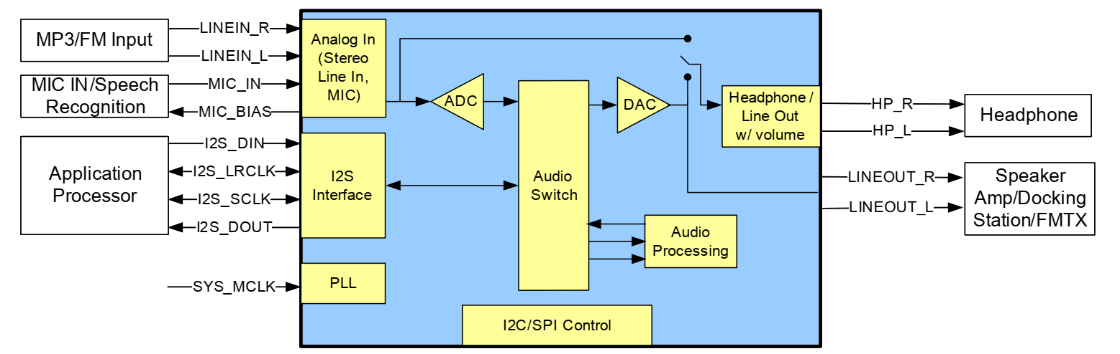
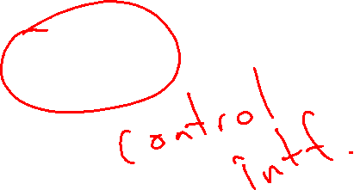
Introducing the SGTL5000 CODEC

Slide 75
Interfacing to the SGTL5000
Two separate interfaces, which you must control from FPGA (or NIOS II)
Control interface (I2C)
Used to set some control registers (e.g. mixer routing, gain levels, etc)
Easily done with the Nios II and the Intel FPGA I2C IP (add in Platform Designer)
Follow register recommendations in SGTL5000 datasheet
Not needed once registers are configured
Audio data interface (I2S)
Used to send and receive audio data
Need to design I2S peripheral on FPGA to interface with synthesizer/oscillator/wavetables (whatever is generating samples)
Need to provide new sample every 1/Fs
Can operate either master mode (FPGA provides clock) or slave mode (SGTL5000 provides clock – slave mode is probably easier due to built in PLL)
In either case, you need to provide 12.5 MHz master clock to SGTL5000

Slide 76
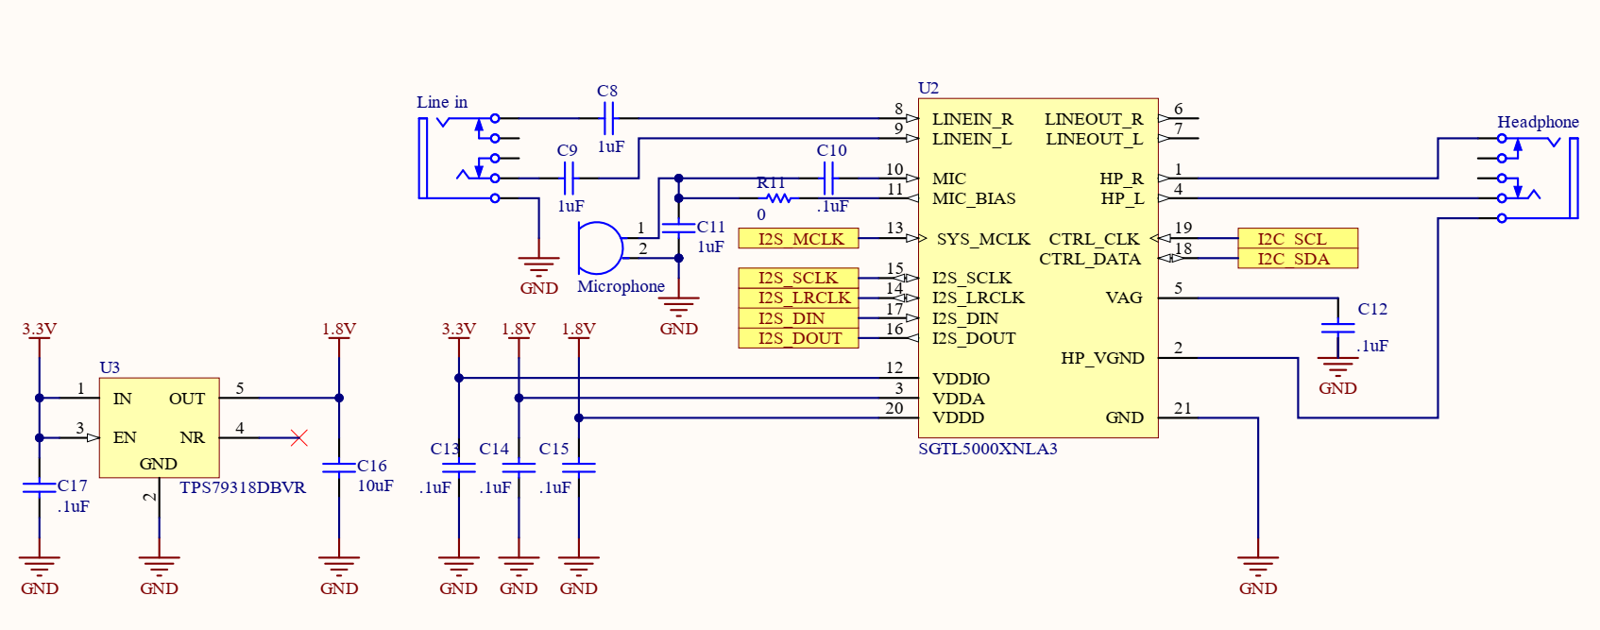
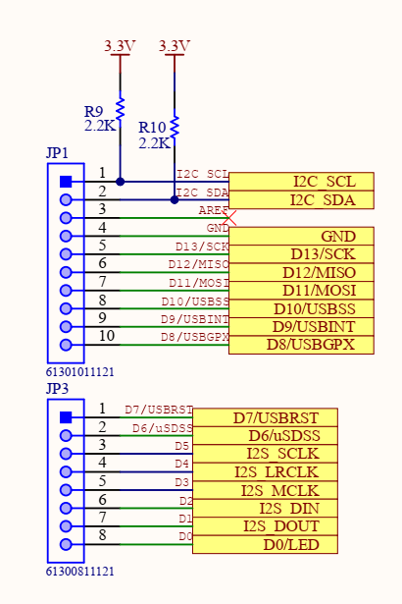
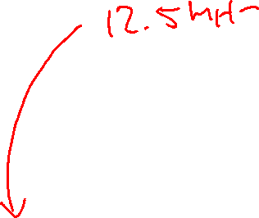
SGTL5000 on DE10-Lite Shield
Notes:
Some takeaways:
Only headphone output is actually wired (even though it is labeled Line Out) – have to make sure headphone amplifier is powered up
XTI/MCLK is fed directly from FPGA pin (need to generate compatible clock from FPGA)
I2C has fixed address (0x34)

Slide 77
I2C Control Bus
Used to set parameters for SGTL5000 (not actual audio samples!)
Parameters include volume of each channel, enabling/disabling headphone amplifier, etc…
I2C requires 2 pins (SDA and SCL)
Each I2C transaction begins with start and ends with stop
I2C is open collector signaling, multiple devices may share bus (any device can pull either line low, resistors pull the line back to high)

Slide 78
I2C Control Bus
Example I2C write operation:
Start Condition
First 8 bits address (0x0A) and R/W bit (ACK)
Next 8 bits of register address (A15-A8) (ACK)
Next 8 bits of register address (A7-A0) (ACK)
Next 8 bits of register data (D15-D8) (ACK)
Final 8 bits register data (D7-D0) (ACK then STOP)
Can implement this using provided Intel FPGA I2C driver and Nios II

Slide 79
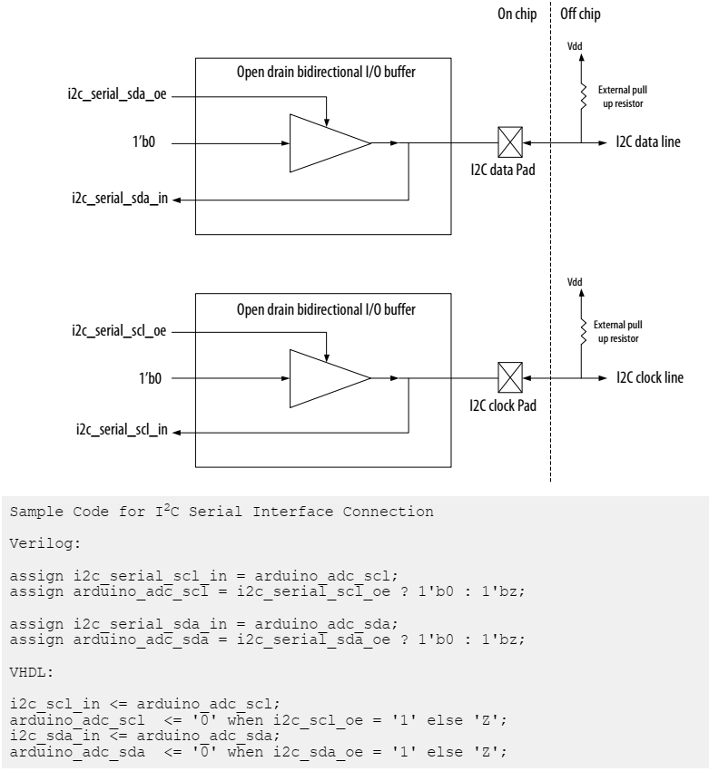
Intel Avalon I2C
Consult the Nios II Embedded IP User Guide (same as for SPI), Chapter 15
Add I2C Peripheral to platform designer as with the SPI peripheral in Lab 6.2
Note that I2C requires tristate buffers, so you will need to add the following lines of Verilog code to your top level after adding the I2C peripheral to Platform Designer
According to Shield schematic:
SCL -> ARDUINO_IO[15]
SDA -> ARDUINO_IO[14]
Also need to provide 12.5 MHz MCLK to SGTL5000:
assign ARDUINO_IO[3] = aud_mclk_ctr[1]; //generate 12.5MHz CODEC mclk
always_ff @(posedge MAX10_CLK2_50) begin
aud_mclk_ctr <= aud_mclk_ctr + 1;
end

Slide 80
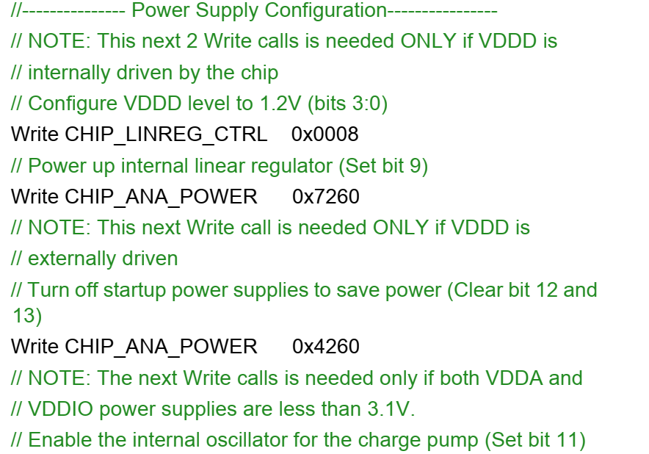
Configuration of SGTL5000 Registers
SGTL5000 register map is complicated due to the large number of sub-modules inside chip
Basic configuration template is provided on page 26 of SGTL5000 datasheet
Provided example C code implements this example, default routing is Line-in -> I2S_out, I2S_in -> Headphone Out
I2S master set to SGTL5000, Fs = 44.1kHz
This code is found under Final Project
//configure power control, disable internal VDDD, VDDIO=3.3V, VDDA=VDDD=1.8V (ext)
SGTL5000_Reg_Wr(i2c_dev, SGTL5000_CHIP_ANA_POWER, \
SGTL5000_DAC_STEREO|
SGTL5000_PLL_POWERUP|
SGTL5000_VCOAMP_POWERUP|
SGTL5000_VAG_POWERUP|
SGTL5000_ADC_STEREO|
SGTL5000_REFTOP_POWERUP|
SGTL5000_HP_POWERUP|
SGTL5000_DAC_POWERUP|
SGTL5000_CAPLESS_HP_POWERUP|
SGTL5000_ADC_POWERUP);
printf( "CHIP_ANA_POWER register: %x\n", SGTL5000_Reg_Rd (i2c_dev, SGTL5000_CHIP_ANA_POWER));

Slide 81
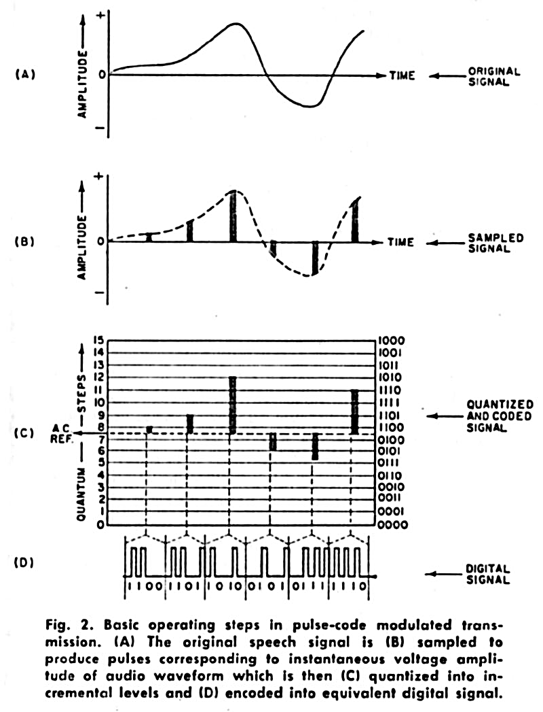
Storage and Playback of Audio
Most straightforward way to represent audio is LPCM (Linear pulse-coded modulation)
This is used by I2S (as well as CD audio and most .wav files)
Constant number of identically encoded bits per second
Inefficient, but easy to store/playback
Typical “CD Quality” = 44.1 kHz, 16 bit

Slide 82
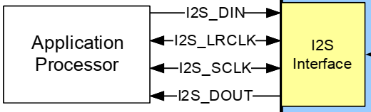

Audio Interface Port
I2C is only part of the challenge, still need to get audio samples into DAC (and audio samples out from ADC, if using both input and output – e.g. guitar effects)
The audio samples go through an interface called I2S, which has 4 signals (Din/Dout/SCLK/LRCLK)
You must create this peripheral (probably on the FPGA using SV) as this is a high-speed peripheral (unlikely Nios II can provide samples fast enough)
Provided code configures SGTL5000 as master, so it generates clocks (SCLK and LRCLK)
Pin assignments are:
ARDUINO_IO[5] = SCLK
ARDUINO_IO[4] = LRCLK
ARDUINO_IO[3] = 12.5Mhz clk
ARDUINO_IO[2] = I2S_Din
ARDUINO_IO[1] = I2S_Dout

Slide 83
I2S Clocks
I2S has three clocks. MCLK is generated by FPGA (12.5MHz) and clocks SGTL5000 circuits. In master mode SGTL5000 generates other clocks.
MCLK (aka oversampling clock) drives the delta-sigma converters and the rest of the SGTL5000 hardware. It goes into a PLL on the SGTL5000 to generate sampling rate frequencies (note that 44.1kHz does not divide evenly from 12.5 MHz)
SGTL5000 generates LRCLK, which is also the same frequency as the sampling rate (e.g. 44.1kHz). LRCLK being low indicates current data is left channel, high indicates current data is right channel
SCLK is typically LRCLK * 64, to have 32-bit times for left channel and 32-bit times for right channel – allowing for a maximum sampling depth of 32-bits
SCLK to LRCLK ratio can be changed via SGTL5000 registers

Slide 84
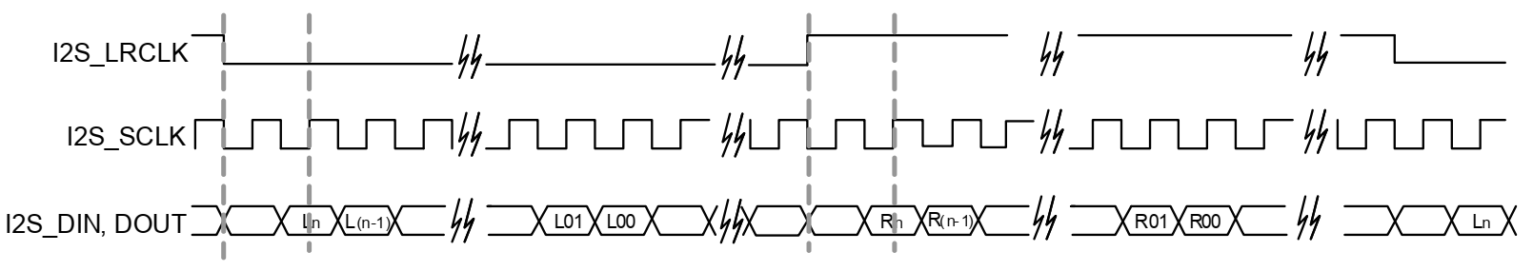
Audio Interface Port
Standard I2S data is shown below. Note that there is one ‘dummy’ SCLK period before data starts
MSB is sent first, by default SGTL5000 works in 24-bit mode, so data is sent: <dummy>, <D23>, D<22>…D<0>
The remaining clock cycles of SCLK unused until the rising edge of LRCLK
When LRCLK changes polarity, the other channel is sent
Easy to implement using a left shift register with parallel load

Slide 85
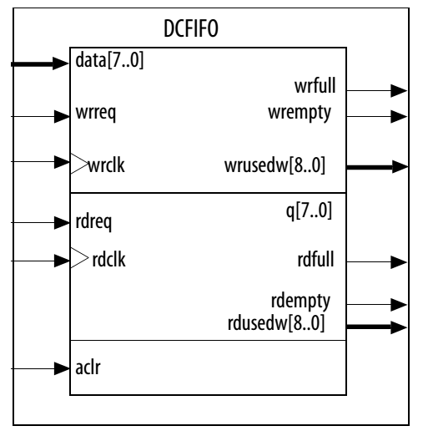
FPGA Dual Clock FIFO
Often, we do not want to process samples synchronous to the sampling rate clock, e.g. we need to process samples faster
Many filters may require multiple clock cycles to process
Like the VGA, the I2S port will require a constant stream of data
Hint: Use the dual-clock fifo to synchronize between different rates
Note: will still need to guarantee FIFO never underruns or overflows
Use the empty/full (or almost empty and almost full) signals to control processing flow

Slide 86
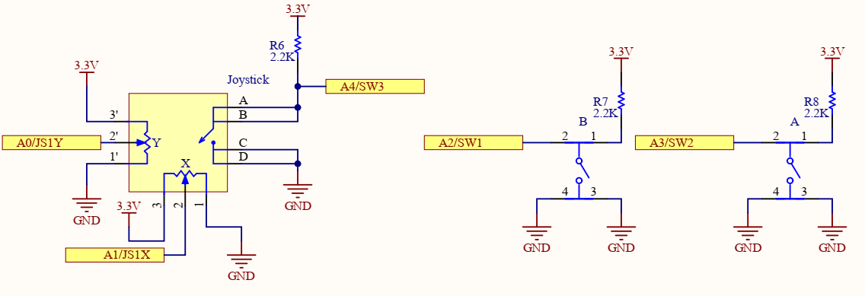
USB Shield Joystick
USB Shield has a built-in analog stick and two pushbuttons which are connected to analog ports
Y Axis – A0
X Axis – A1
B Button – A2
A Button – A3
Joystick click-button – A4
Max10 FPGA has 12-bit ADC converter, but maximum voltage is only 2.5V
Analog circuit included on DE10-Lite FPGA board to scale 5V-2.5 V (op-amp)
Switches and joystick pulled up to 3.3V, so read scale should be 0-(3.3/5.0) * (2^12-1) = [0-2703]

Slide 87
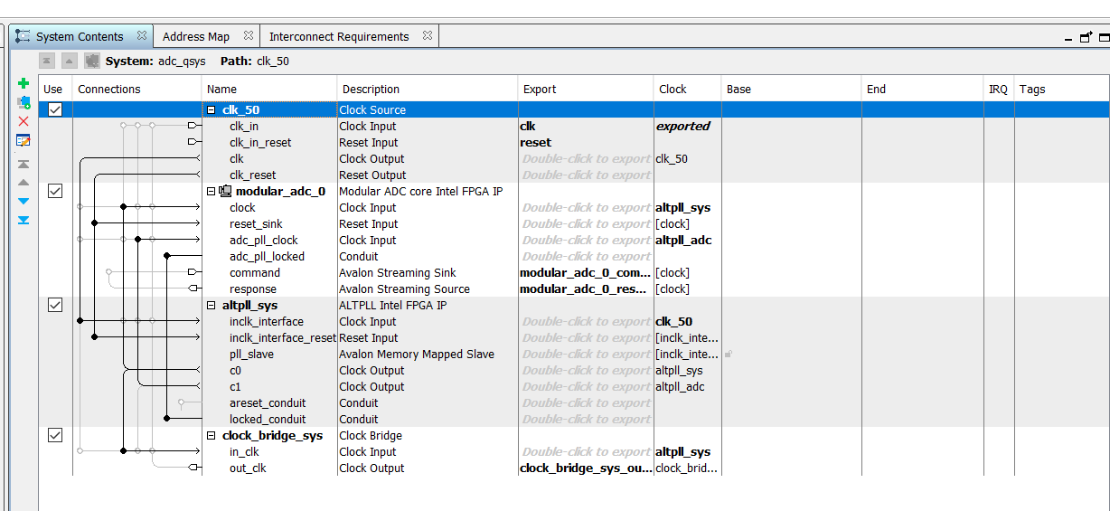
ADC Module
ADC Module is implemented as a hard-IP block (meaning it is physically implemented in silicon on the FPGA, unlike the Nios II CPU)
Platform Designer must be used to instantiate the ADC modules, internally it is implemented using the Avalon Streaming Bus
ADC also needs a 10 MHz clock, can either be generated internally via PLL or externally via external crystal
See ADC_RTL example on DE10-Lite examples for this Qsys

Slide 88
ADC Module
ADC Module is implemented as a hard-IP block (meaning it is physically implemented in silicon on the FPGA, unlike the Nios II CPU)
Platform Designer must be used to instantiate the ADC modules, internally it is implemented using the Avalon Streaming Bus
ADC also needs a 10 MHz clock, can either be generated internally via PLL or externally via external crystal
See ADC_RTL example on DE10-Lite examples for this Qsys

Slide 89
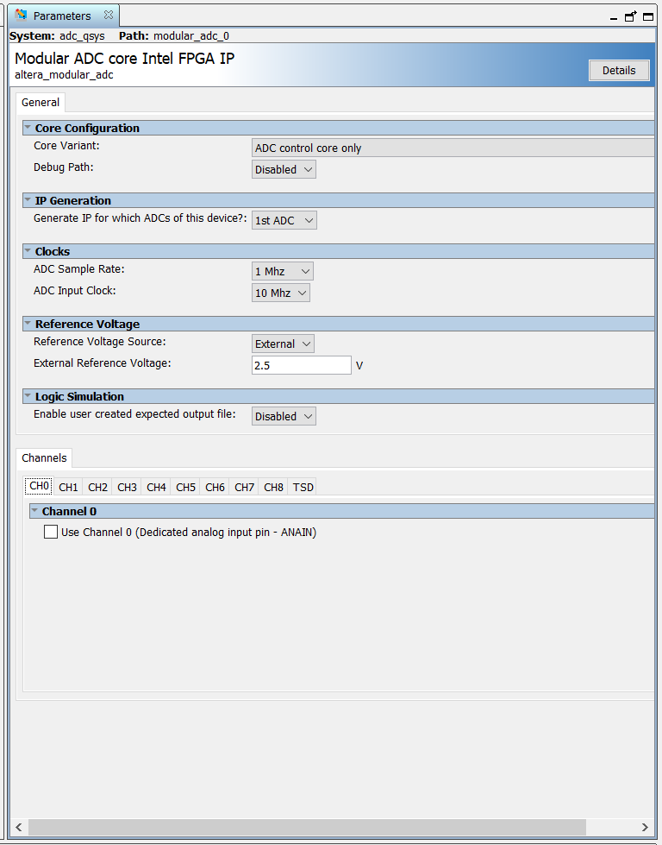
ADC Module
ADC Module samples all enabled channels according to the sequencer (CH0, CH1, CH2…)
Arduino ADC channels are mapped to CH1 through CH6, though CH6 is unused on USB shield – there are only 5 signals
CH0 and ‘TSD’ are treated as analog channels, even though they function differently
By default, set to sample at 1MHz which is maximum sampling frequency
Data from ADC is streamed out using Avalon Streaming Bus (note that this is different than the Avalon-MM bus)

Slide 90
Using ADC Module in SV
module adc_qsys (
input wire clk_clk, // clk.clk
output wire clock_bridge_sys_out_clk_clk, // clock_bridge_sys_out_clk.clk
input wire modular_adc_0_command_valid, // modular_adc_0_command.valid
input wire [4:0] modular_adc_0_command_channel, // .channel
input wire modular_adc_0_command_startofpacket, // .startofpacket
input wire modular_adc_0_command_endofpacket, // .endofpacket
output wire modular_adc_0_command_ready, // .ready
output wire modular_adc_0_response_valid, // modular_adc_0_response.valid
output wire [4:0] modular_adc_0_response_channel, // .channel
output wire [11:0] modular_adc_0_response_data, // .data
output wire modular_adc_0_response_startofpacket, // .startofpacket
output wire modular_adc_0_response_endofpacket, // .endofpacket
input wire reset_reset_n // reset.reset_n
);
Most signals related to the ADC command bus, so to continuously sample only a few signals are needed:
Clock (50Mhz clock), reset
Valid, start of packet, end of packet can be set to 1’b1;
Command channel indicates the sample channel, can be a counter which goes from 4’b0001 to 4’b0110
Your logic must monitor response valid, response channel, response data

Slide 91
Using ADC Module in SV
module adc_qsys (
input wire clk_clk, // clk.clk
output wire clock_bridge_sys_out_clk_clk, // clock_bridge_sys_out_clk.clk
input wire modular_adc_0_command_valid, // modular_adc_0_command.valid
input wire [4:0] modular_adc_0_command_channel, // .channel
input wire modular_adc_0_command_startofpacket, // .startofpacket
input wire modular_adc_0_command_endofpacket, // .endofpacket
output wire modular_adc_0_command_ready, // .ready
output wire modular_adc_0_response_valid, // modular_adc_0_response.valid
output wire [4:0] modular_adc_0_response_channel, // .channel
output wire [11:0] modular_adc_0_response_data, // .data
output wire modular_adc_0_response_startofpacket, // .startofpacket
output wire modular_adc_0_response_endofpacket, // .endofpacket
input wire reset_reset_n // reset.reset_n
);
Avalon Streaming Interface implements a data stream, useful in cases where data is sequential
ADC module will continuously convert channels in sequence, up to 64 slots may be sequenced for high-speed captures directly from ADC
We will only capture a single channel at a time (hence start of packet and end of packet can be hard-wired to 1’b1)

Slide 92
Using ADC Module in SV
module adc_qsys (
input wire clk_clk, // clk.clk
output wire clock_bridge_sys_out_clk_clk, // clock_bridge_sys_out_clk.clk
input wire modular_adc_0_command_valid, // modular_adc_0_command.valid
input wire [4:0] modular_adc_0_command_channel, // .channel
input wire modular_adc_0_command_startofpacket, // .startofpacket
input wire modular_adc_0_command_endofpacket, // .endofpacket
output wire modular_adc_0_command_ready, // .ready
output wire modular_adc_0_response_valid, // modular_adc_0_response.valid
output wire [4:0] modular_adc_0_response_channel, // .channel
output wire [11:0] modular_adc_0_response_data, // .data
output wire modular_adc_0_response_startofpacket, // .startofpacket
output wire modular_adc_0_response_endofpacket, // .endofpacket
input wire reset_reset_n // reset.reset_n
);
We send command packet which consists of a channel to capture (e.g. command_channel = 4’b0110 to capture channel 5 AKA joystick button
Some time later, ADC module returns a response where valid == 1’b1
Verify that channel == 4’b0110, read data
Note that switches are mapped active low, a number near 0 for data indicates pressed switch, a number near 2700 indicates released switch
Check out ADC_RTL example for a simple ‘manual’ example of this
Can drive with a simple FSM to count through channels 1-5

